Slide 1


FinDash
Hina Hussain
15 November 2021

Slide 2
Product _ “FinDash
Product Goals & Challenges
To build a window into the world of S&P 500.
To build a one stop solution for stock market enthusiasts. All important data is present in the dashboard.
To present stock market data in an interactive dashboard.
To help investors view the trends in their portfolio.
To help investors see predictions and VAR of their stock.

Slide 3
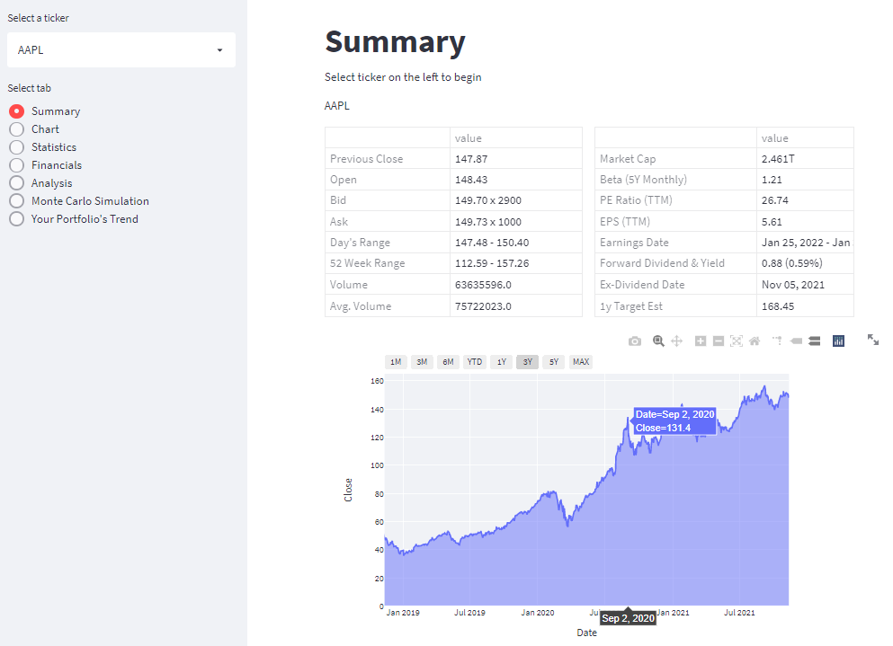
Tab 1
View important statistics
View trend of close price for selected period

Slide 4
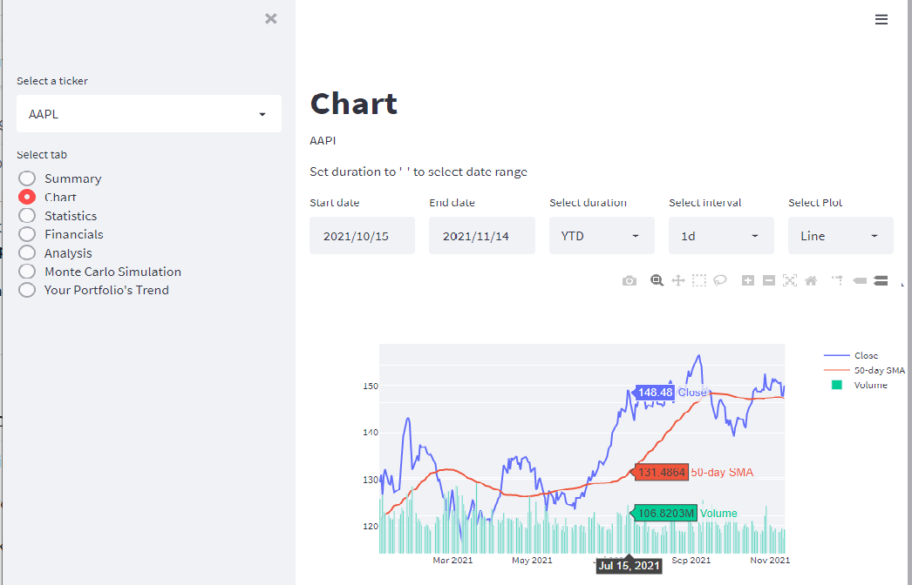
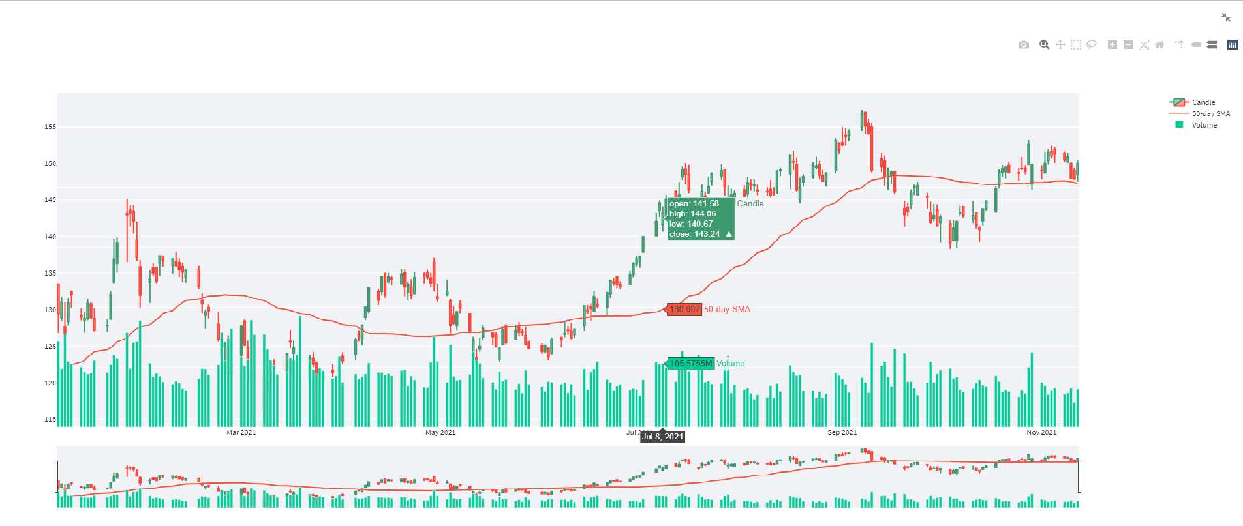
Tab 2
View three plots in one figure
Choose your desired parameters
See datapoints as you hover

Slide 5
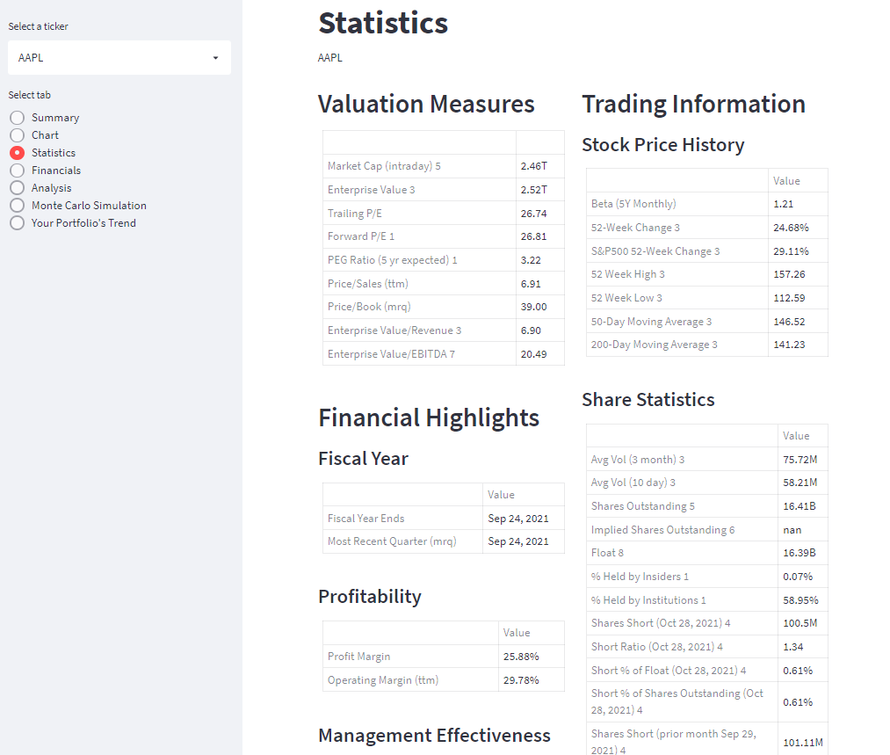
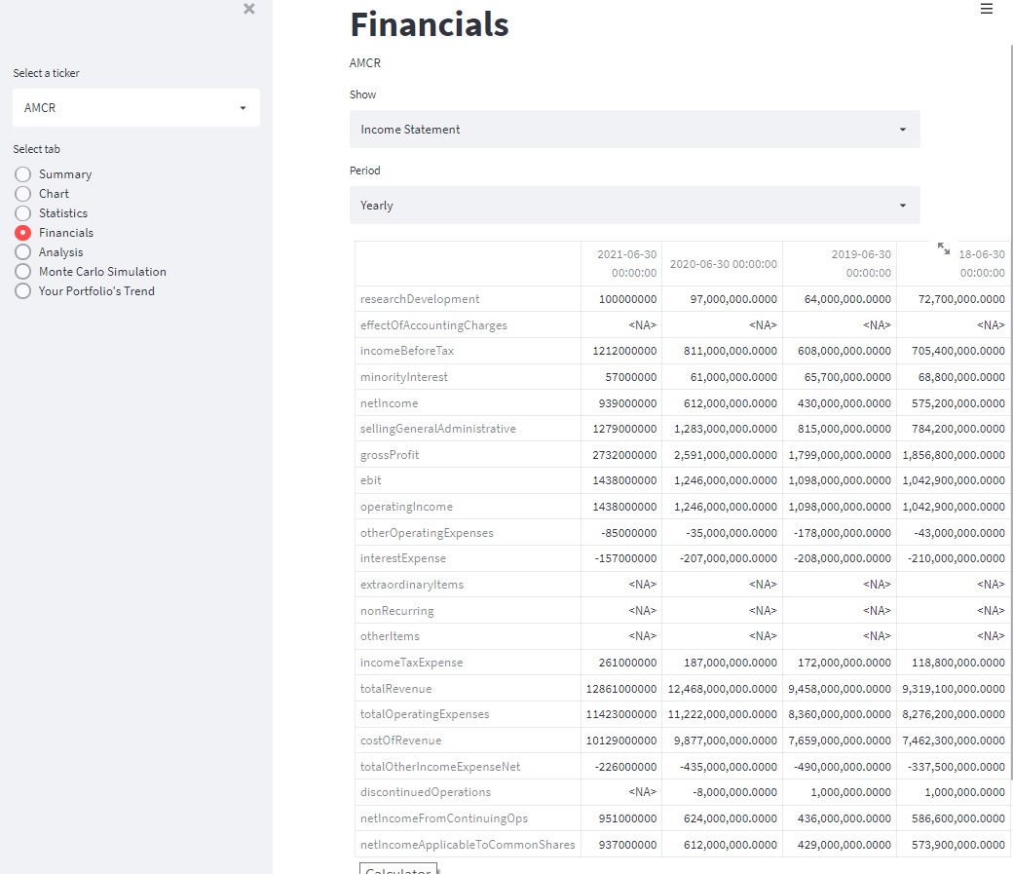
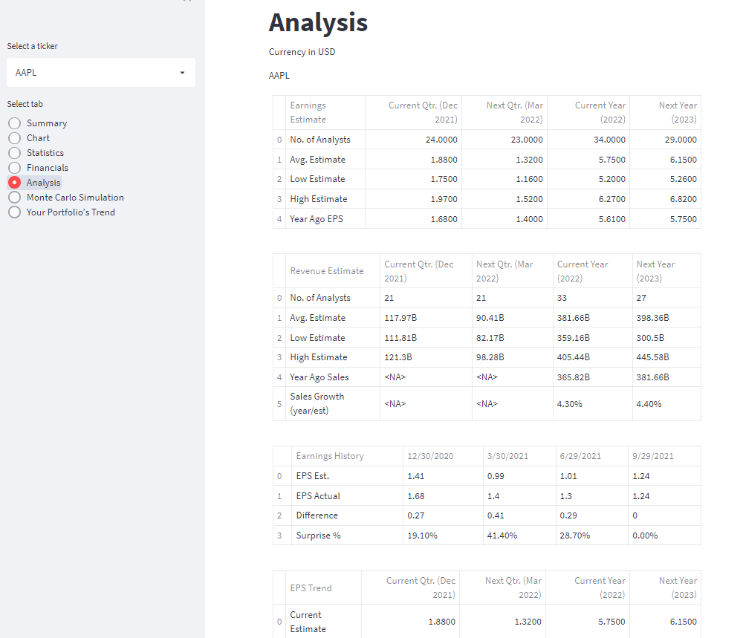
Tab 3, 4 & 5
View clearly labelled statistics
View all financial statements with the option for period selection
View all analysis information

Slide 6
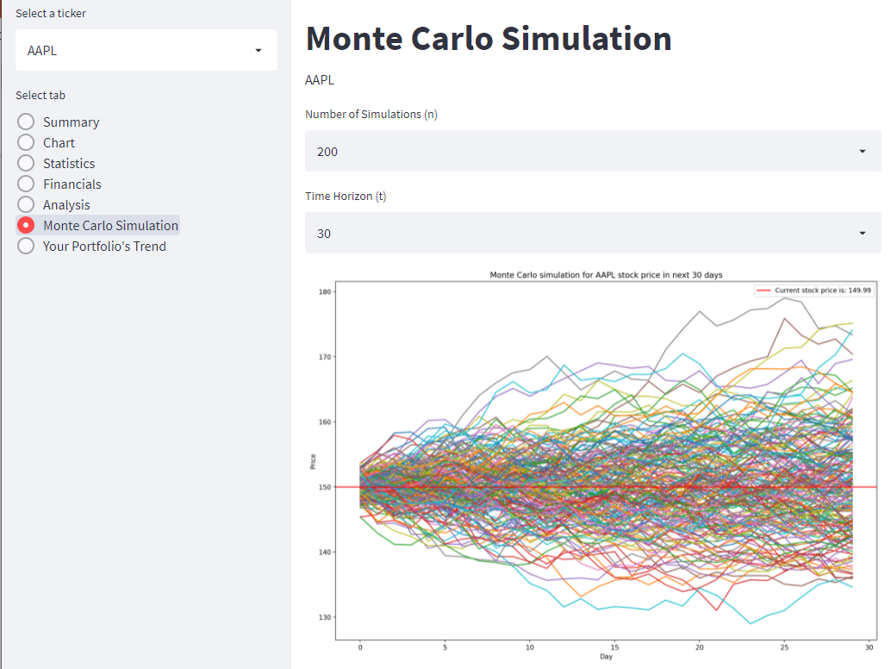
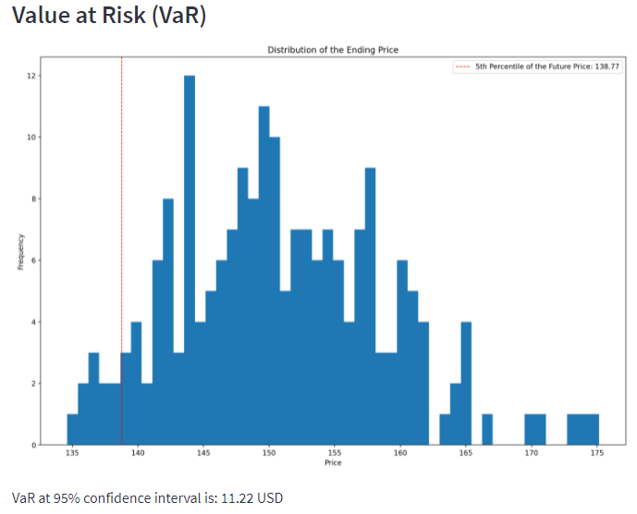
Tab 6
View stock price prediction
Select between time horizon and number of intervals
Value at risk calculated for you

Slide 7
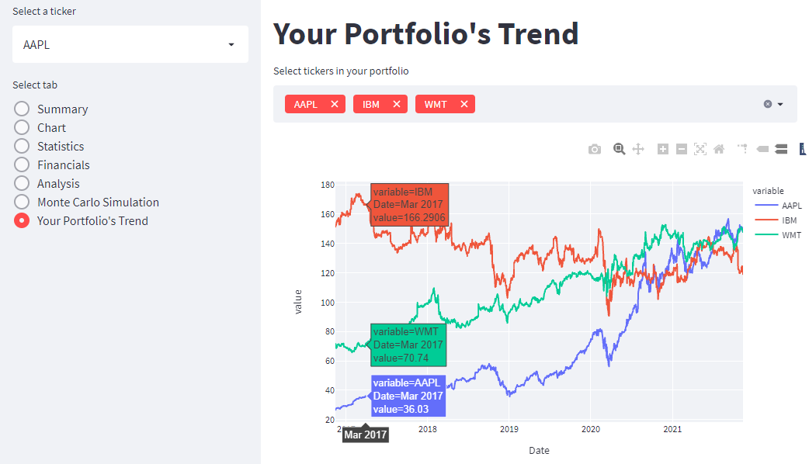
Tab 7
View price trend for all the stocks in your portfolio

Slide 8
How was the product built?
Data was scraped from Yahoo Finance website using Python libraries yahoo_fin.stock_info and Yfinance.
Dashboard was built using Spyder & Streamlit.
Data was processed using Python libraries Pandas, Numpy, and Datetime.
Data visualization was done using Python libraries Matplotlib and Plotly.

Slide 9
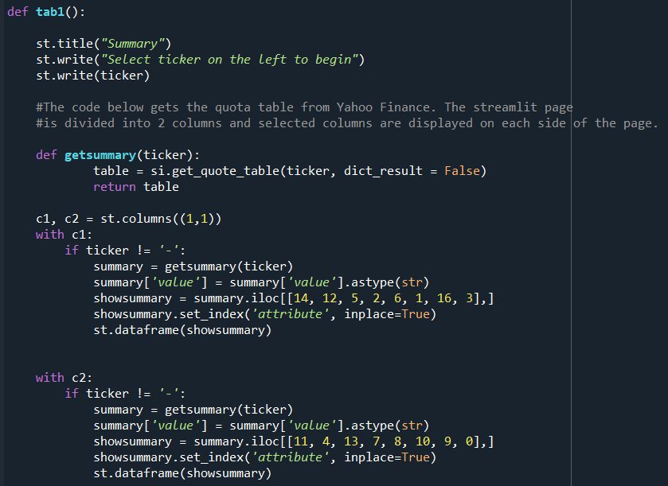
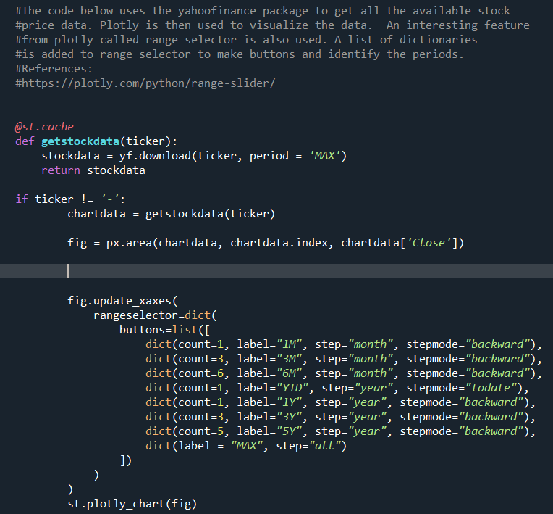
Sample Codes
How to scrape and display a table
Chart with buttons for selecting period

Slide 10
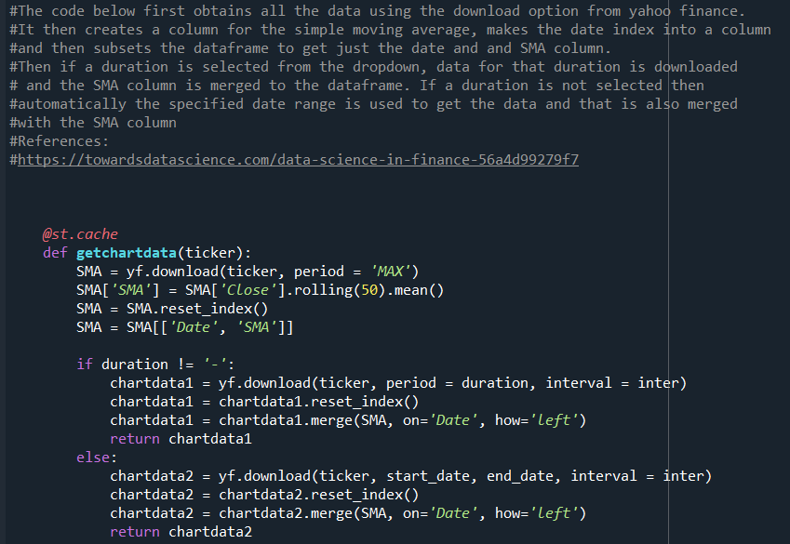
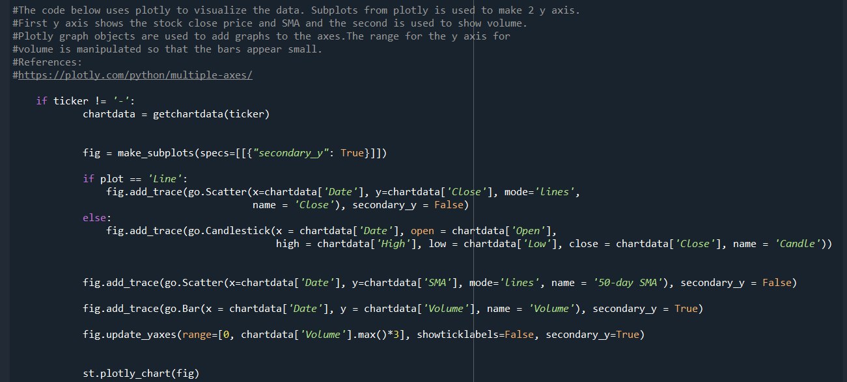
Sample Codes
Data Manipulation
Multiple graphs in same figure

